Slide 1


Kanban - Board
Full Stack Software Project
Presented By :
Saadiyah Jabeen
Gaurav
Deepak Tomar

Slide 2

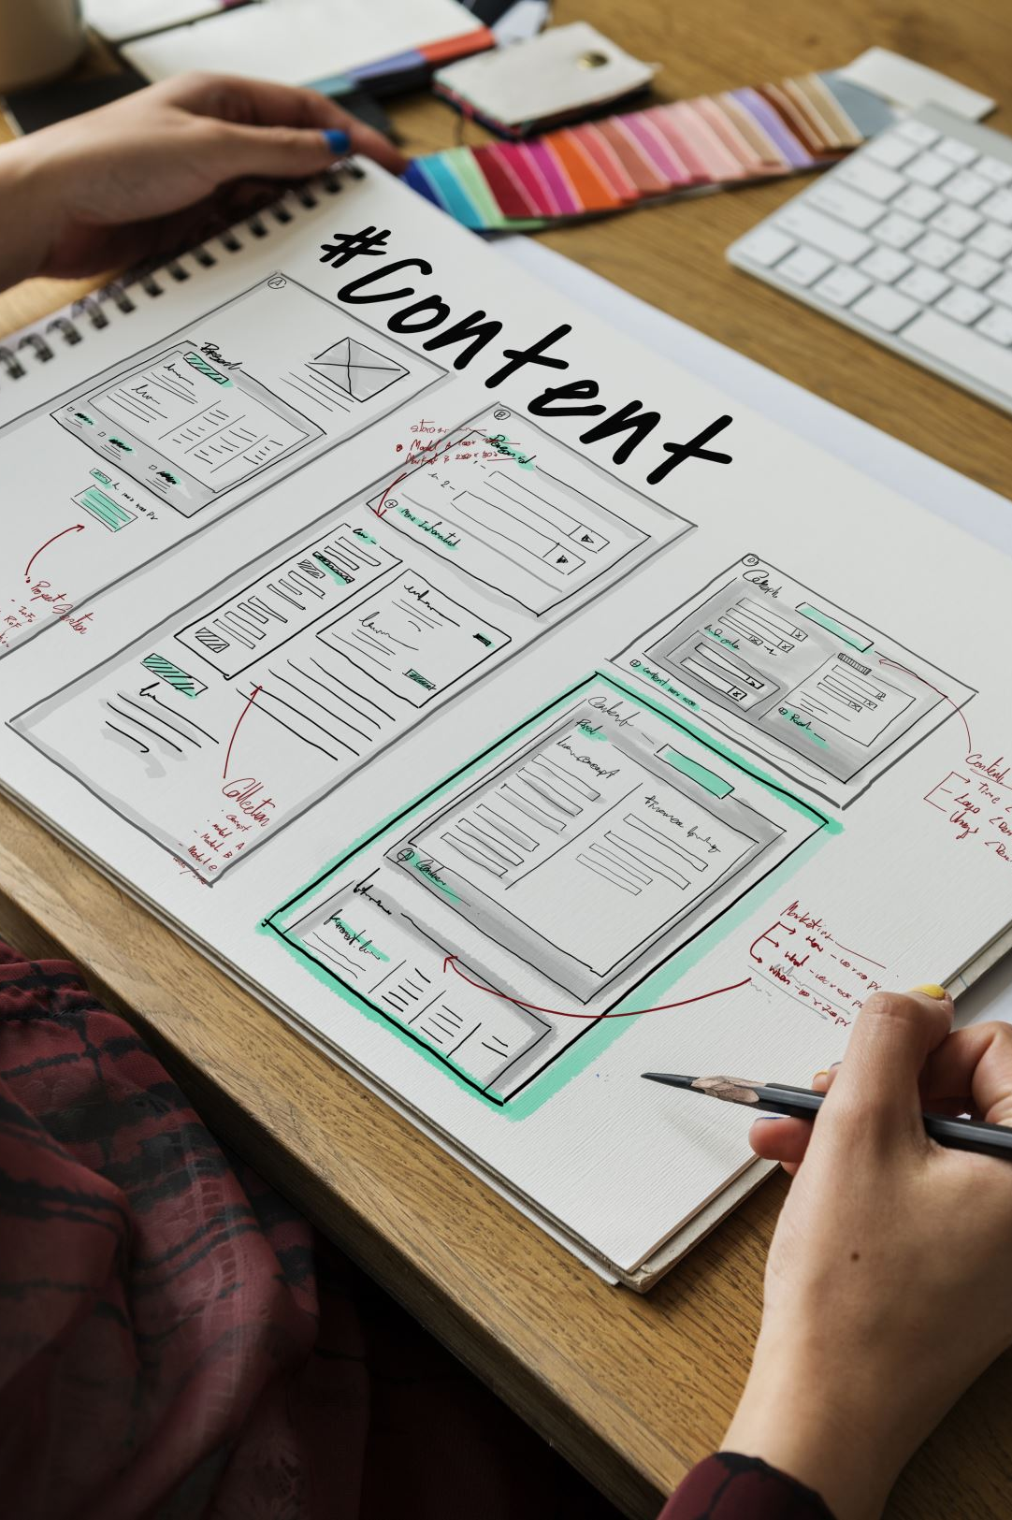
Content
Objective Technologies used Backend Architectural Diagram Work Flow Diagram Features Implemented Web Application Pages

Slide 3
Objective
Kanban board and its relevance in project management.
Intention to improve workflow efficiency, task visibility, and collaboration among team members.
User-friendly digital Kanban board to replace manual methods.
Streamline the movement of tasks from “one-status" to “other-status," reflecting the project's progression.
Visual cues like color coding and labels to represent priorities.

Slide 4


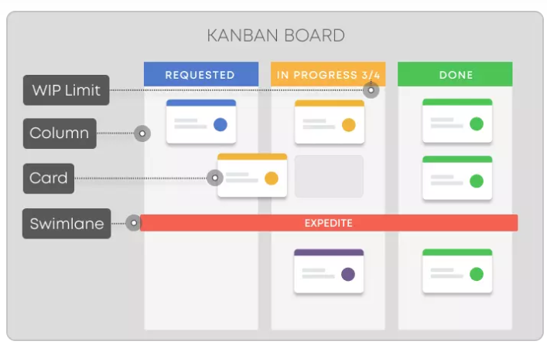
Introduction
A kanban board is an agile project management tool designed to help visualize work, limit work-in-progress, and maximize efficiency (or flow). It can help agile teams establish order in their daily work

Slide 5







Tools and Technology
Backend: Java, Spring Boot, Micro-services, Docker, APIGateway, RabbitMQ, EurekaServer
Frontend: Angular, HTML, CSS, Angular Material.
Databases: MYSQL, MONGODB
Tools Used: draw.io

Slide 6
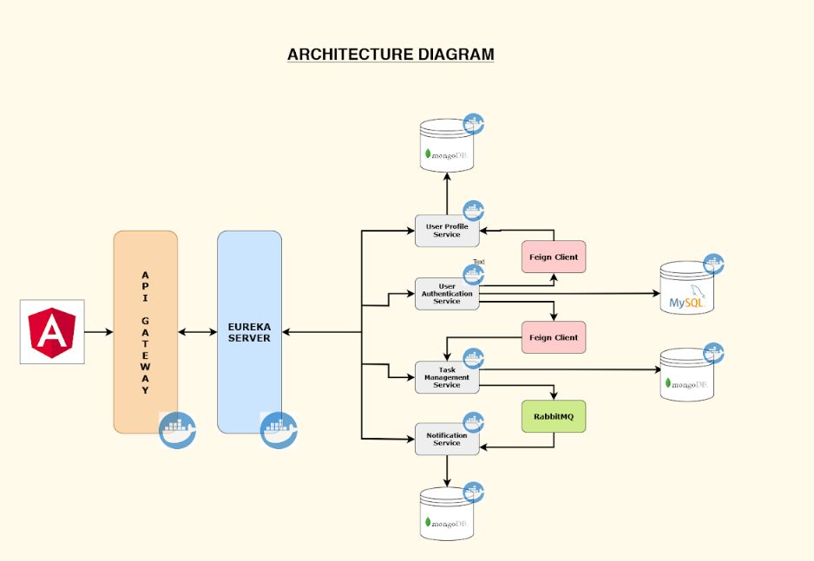
ARCHITECTURE
DIAGRAM

Slide 7
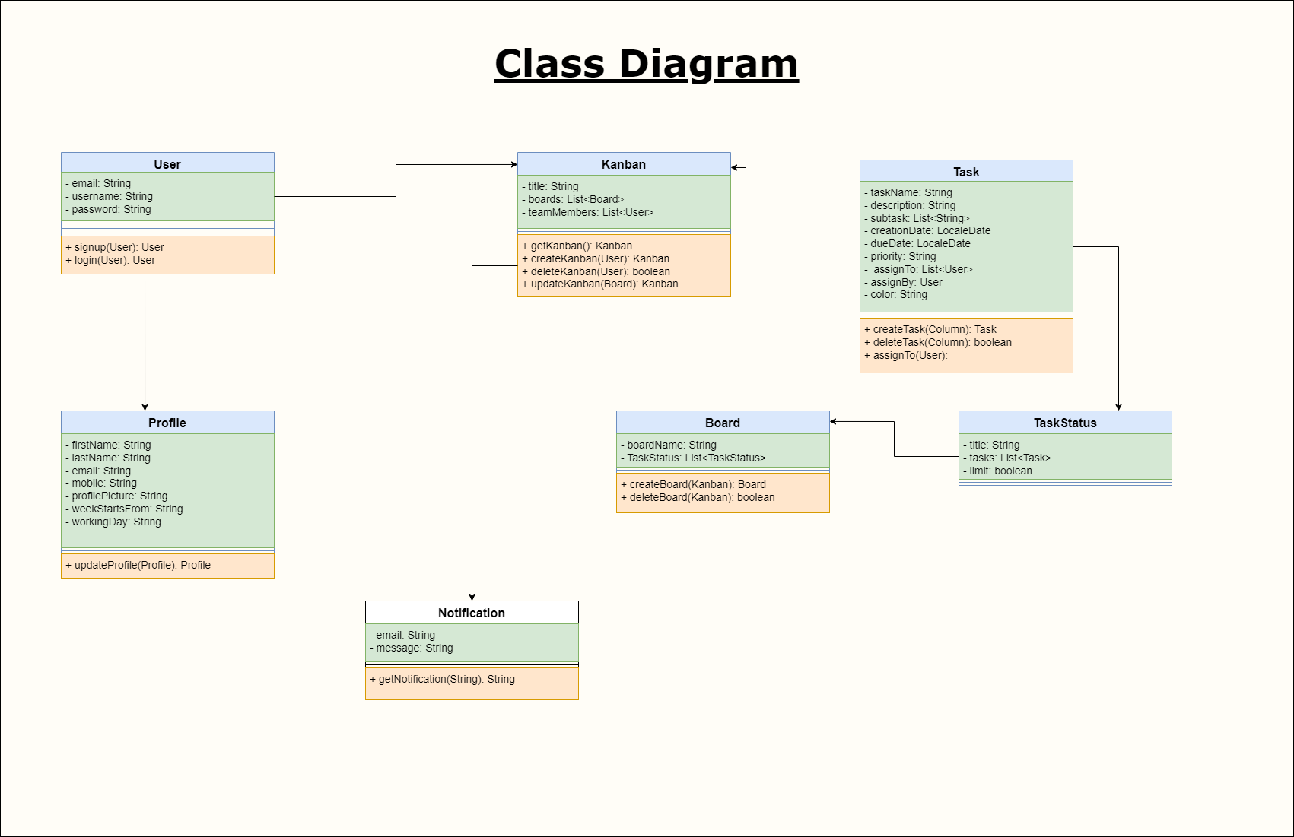
CLASS
DIAGRAM

Slide 8
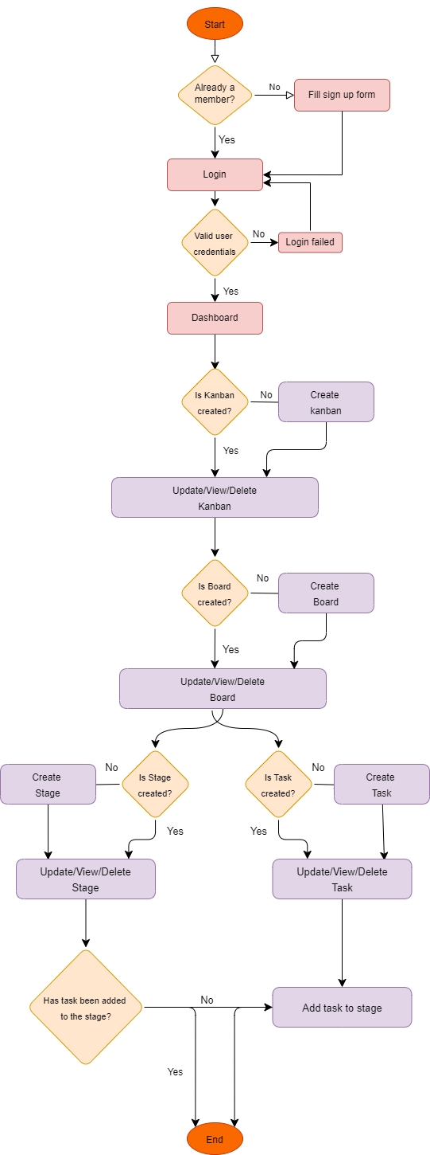
FLOW DIAGRAM

Slide 9

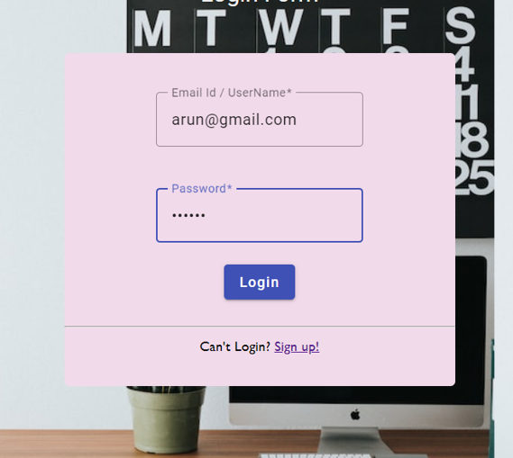
Outputs

Slide 10
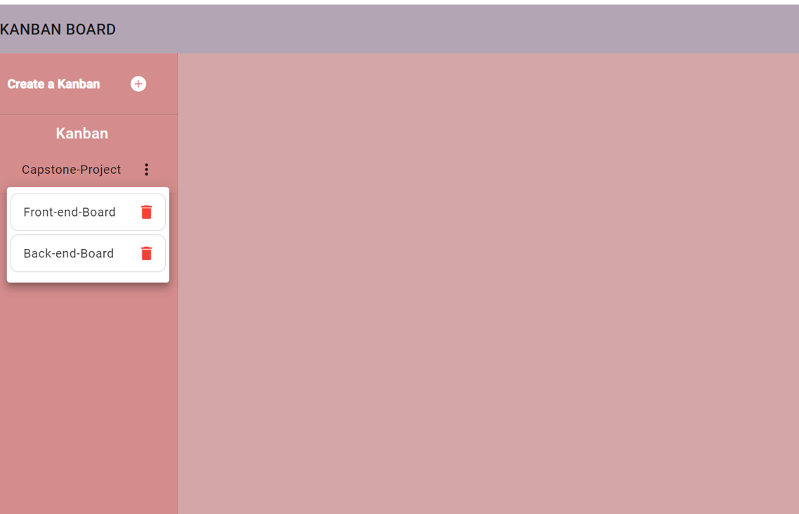
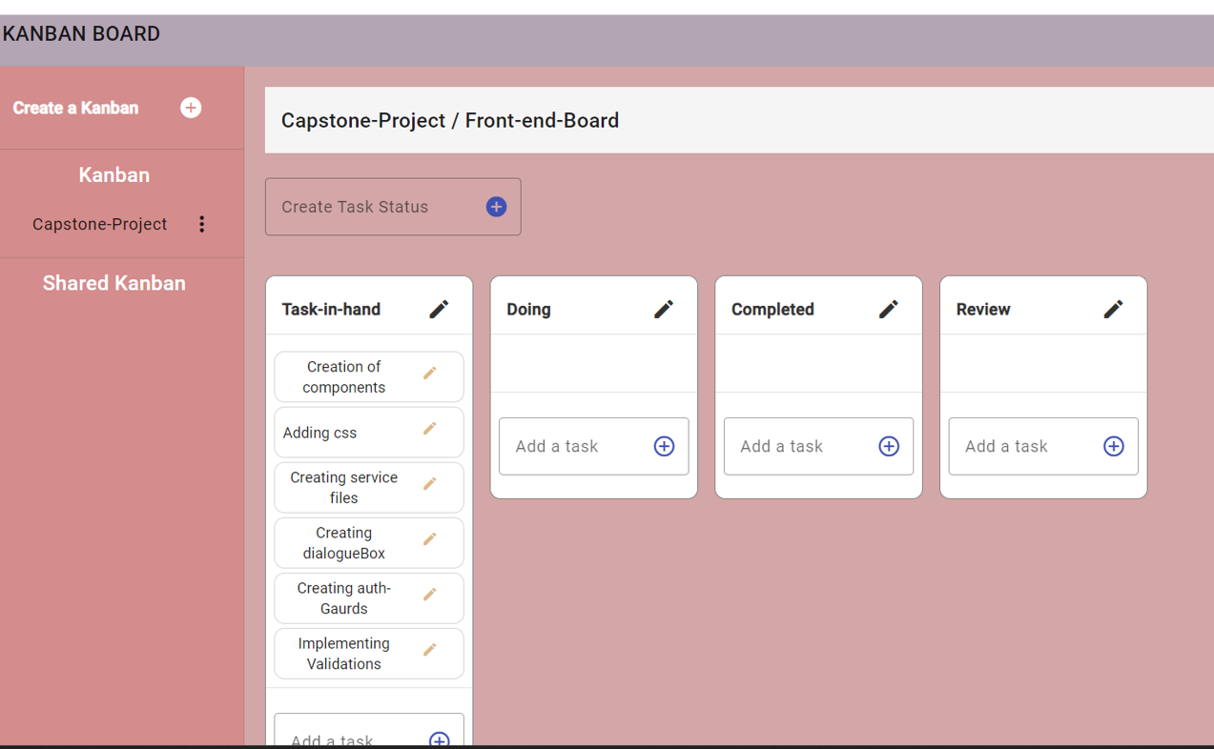

Slide 11
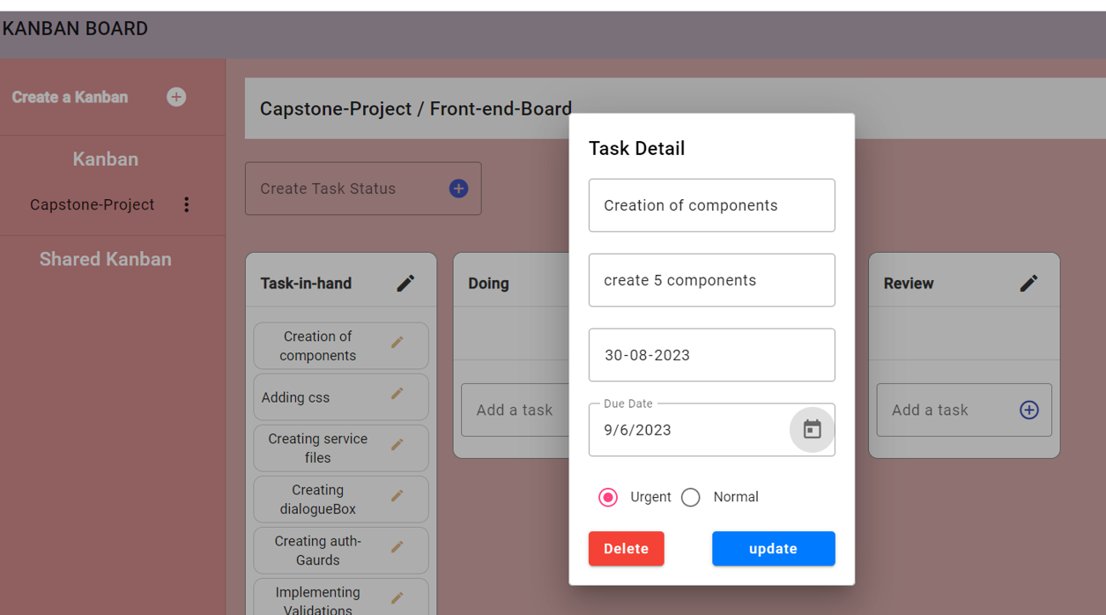
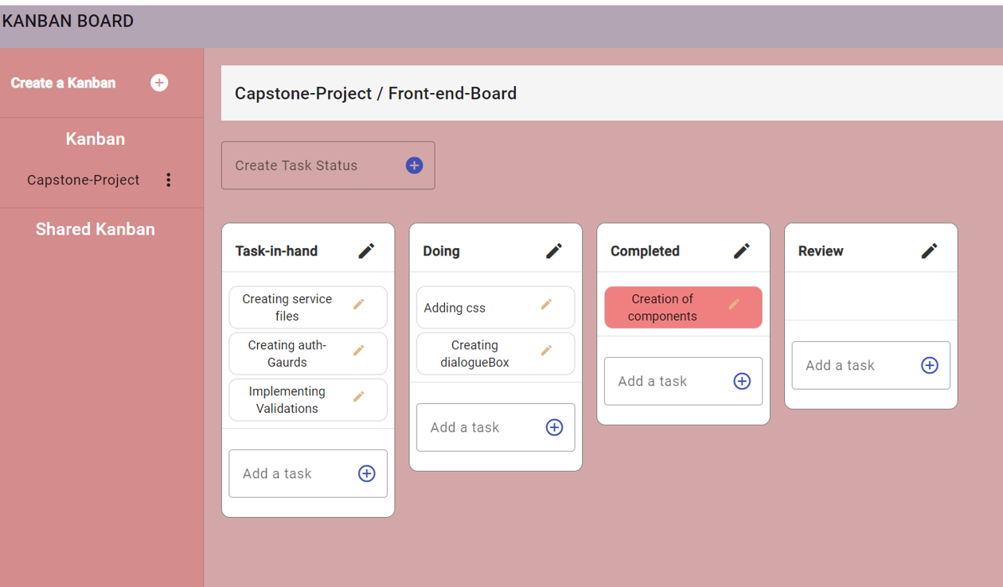

Slide 12
Future Developments
Notification can be sent on WhatsApp and Email.
More views can be added.

Slide 13
Conclusion
In conclusion, our project successfully achieved its goals and objectives. Through the use of Angular on the frontend and Java on the backend, we were able to create a robust and scalable application that met the needs of our users.
We faced several challenges along the way, including database design and testing, but through perseverance and collaboration, we were able to overcome these obstacles and deliver a high-quality product. We are proud of what we have accomplished and look forward to future projects where we can apply the lessons learned from this experience.

Slide 14
Contribution
API Gateway Service - Gaurav
Eureka Service - Gaurav
Authentication Service - Team
Notification Service - Saadiyah
Task Management Service - Team
Profile Service - Deepak
Frontend - Team
Submitted to Rohit Sir & Rakesh Sir

Slide 15

Acknowledgment
Rohit Kumar
Priyanka
Vaibhav diwan
Haseeb Ghalib
Rakesh Pandit
Juneita Shivshankar
Odette Machado

